Slide 1

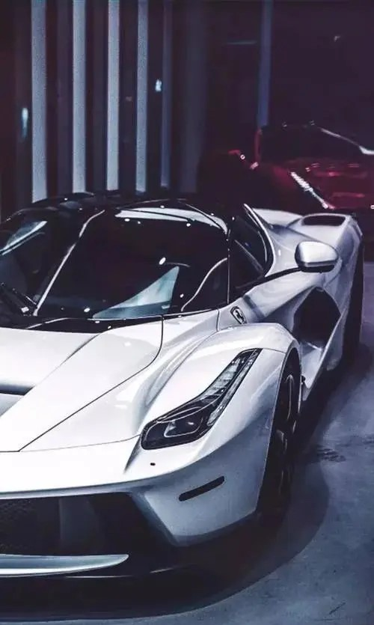
COMP9444
Nexa
Image Segmentation
IMAGE
SEGMENTATION
IN
AUTONOMOUS DRIVING
COMP9444 TEAM NEXA
14/11/2023

Slide 2
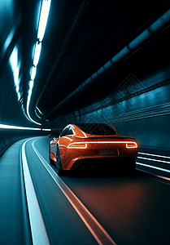
TABLE OF CONTENTS
1
INTRODUCTION OF PROJECT BACKGROUND
2
DATASET / AUGMENTATION
3
3 DIFFERENT TECHNIQUES / MODELS
4
RESULT & DISCUSSION
5
CONCLUSION

Slide 3

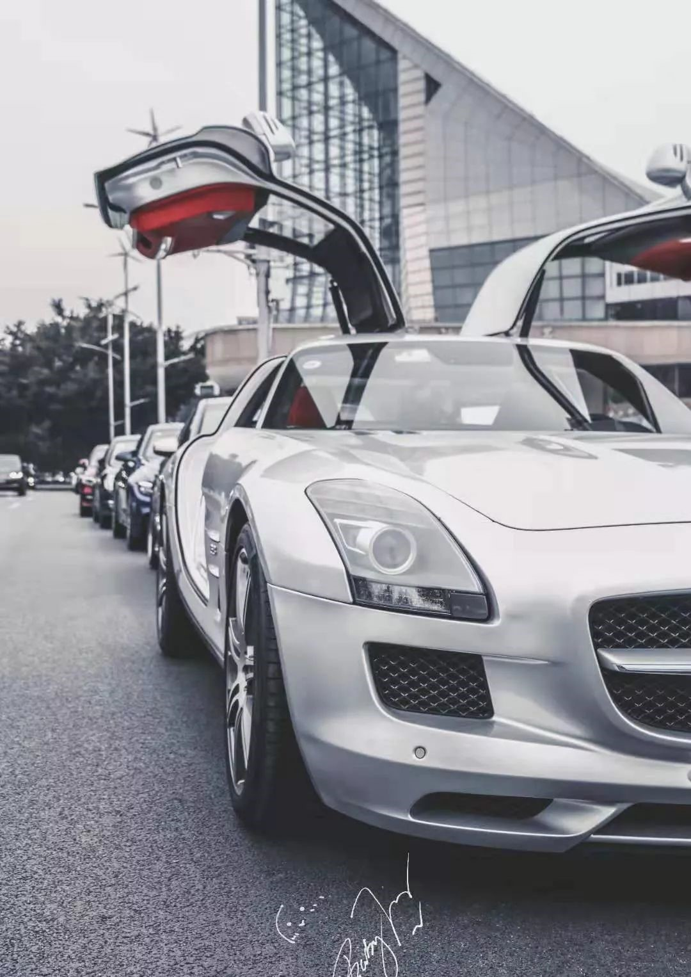
COMP9444
Nexa
Image Segmentation
ABOUT US
NEIL LIAO z5187710
JINGJIE XU z5442663
ZE CHEN z5449848
HANGWEI LIANG z5499015
NUO CHEN z5451234

Slide 4
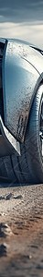
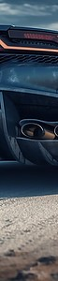
INTRODUCTION OF THE PROJECT
Background
- Objective: Assess the effectiveness of image segmentation techniques in the context of autonomous driving.
- Significance: Improving the perception capabilities of autonomous vehicles, ensuring their safe and efficient operation in complex real-world environments.
- Solution: Evaluating the performance of 3 different segmentation models in accurately identifying for autonomous driving, such as lanes, vehicles, pedestrians, and traffic signs.

Slide 5
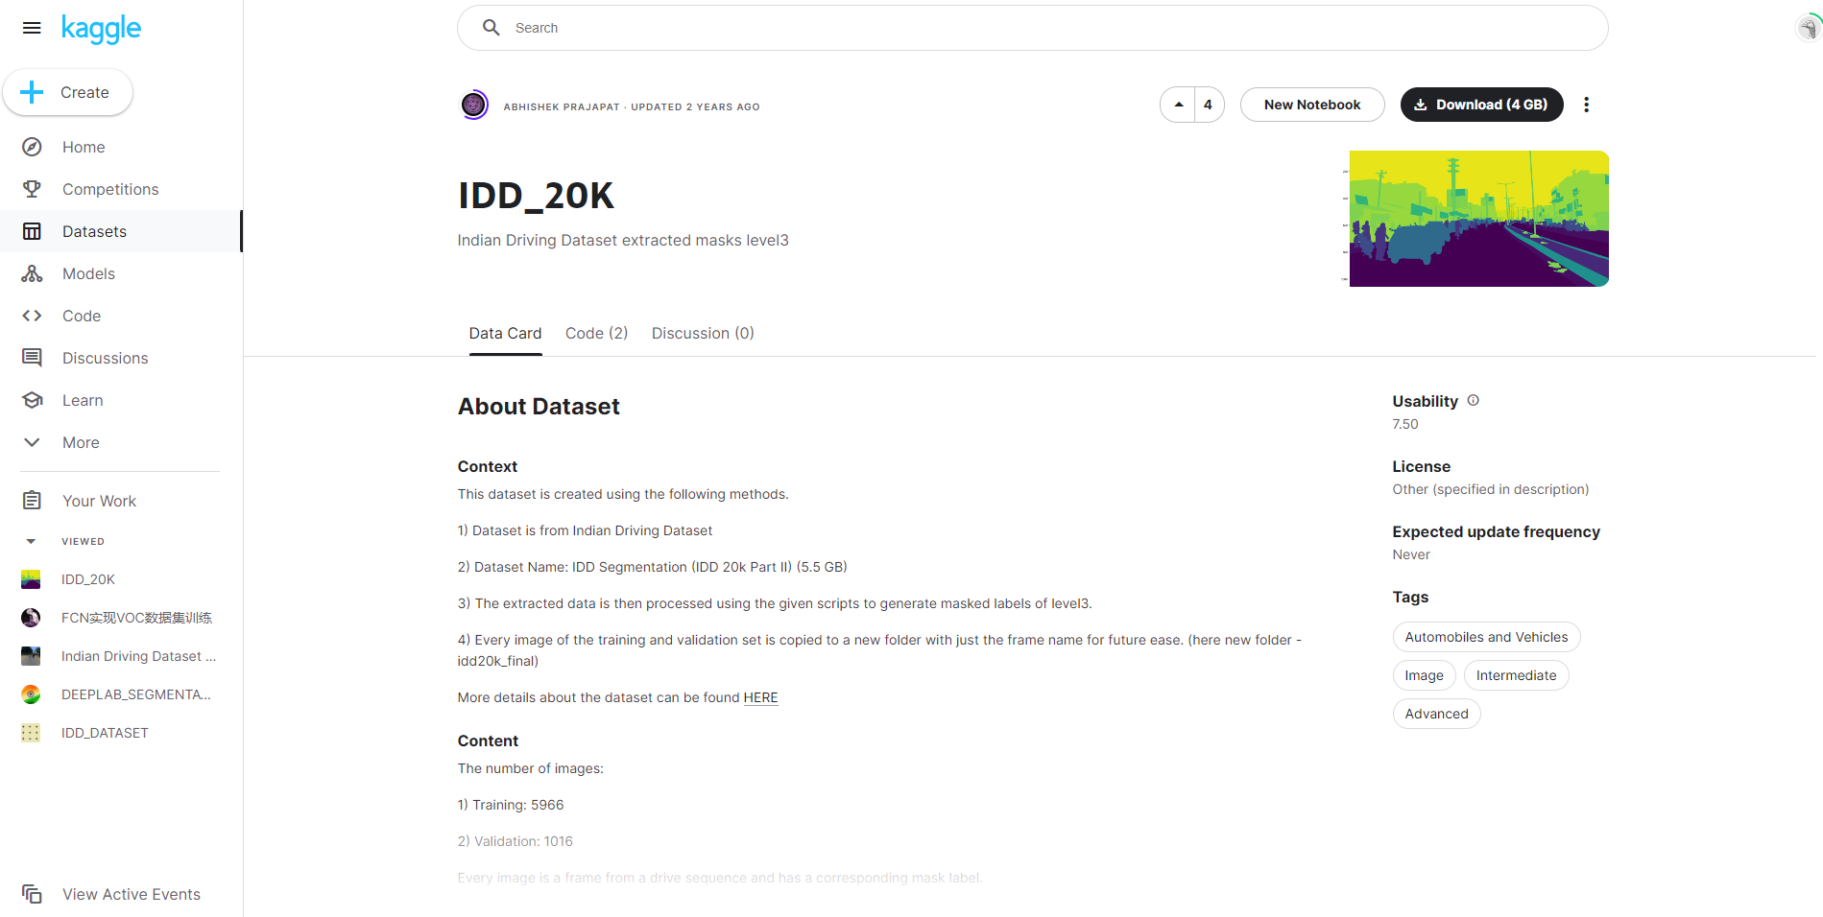
https://www.kaggle.com/datasets/abhishekprajapat/idd-20k/data
DATASET – INDIAN DRIVING DATASET
Overview: The dataset includes diverse images relevant to autonomous driving, covering road scenes, traffic signs, pedestrians, and vehicles.
Data Sources: The images were sourced from publicly available datasets from Kaggle.
Dataset Curation: Rigorous quality control measures were applied to ensure the relevance and accuracy of the data for training and evaluating image segmentation models.
Preprocessing Steps: The original dataset includes 5,966 training images and 1,016 validation images. To ensure a prompt images quality we also use various preprocessing techniques, including data augmentation, were implemented to add around 3,000 images.

Slide 6

U-NET
Encoder-Decoder Architecture:
Encoder: Utilizes a convolutional network for feature extraction, progressively reducing spatial resolution to capture high-level abstract features of the image.
Decoder: Restores the feature map to the original resolution through upsampling, aiding in the recovery of details lost during encoding.
Skip Connection: Introduces skip connections, combining shallow features from the encoder with corresponding layers in the decoder, facilitating effective localization and preservation of fine details.

Slide 7
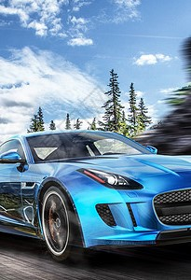
MODELS
U-NET
SEGNET
Deeplabv3

Slide 8
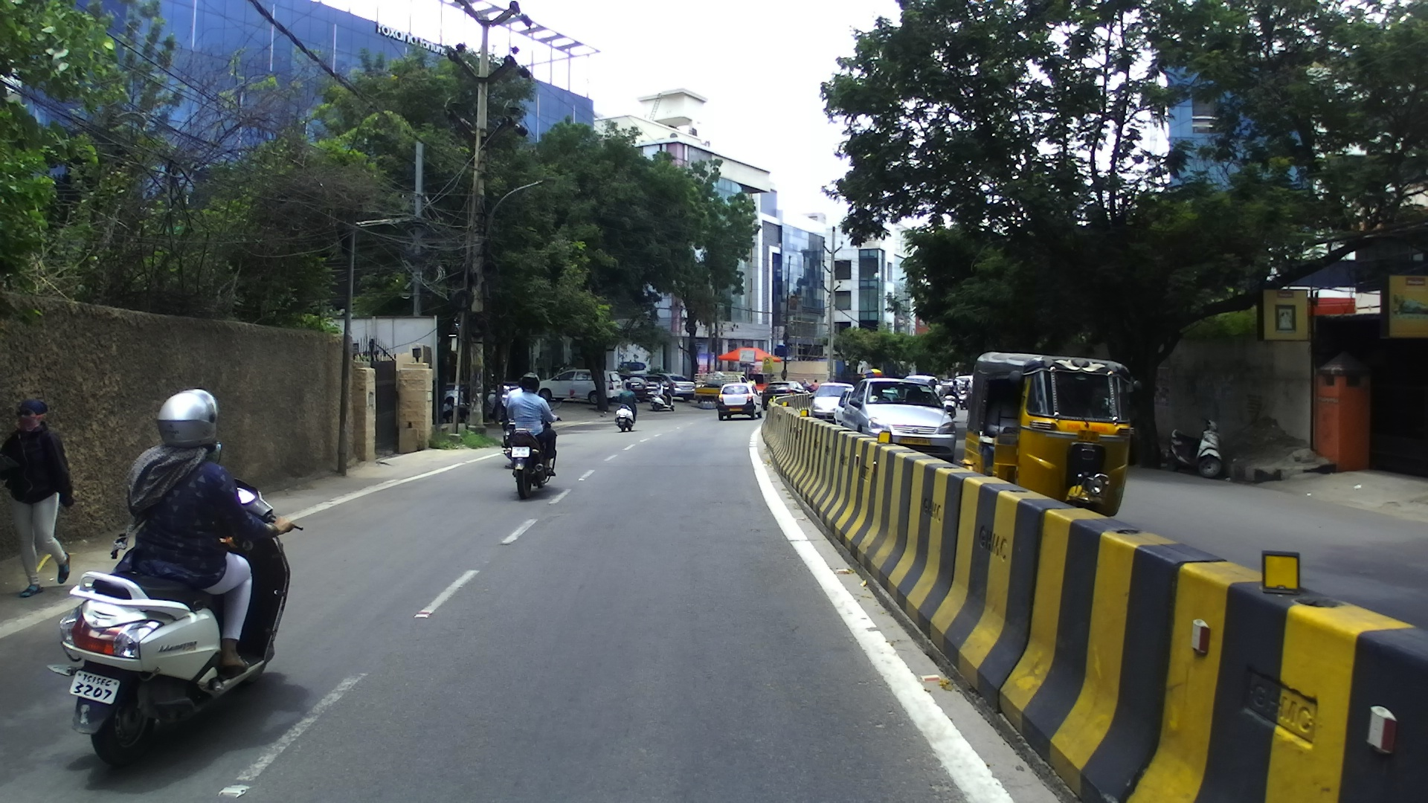
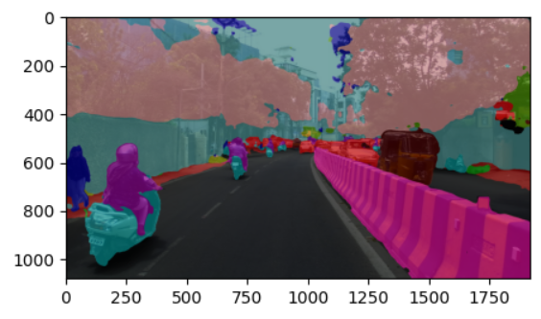
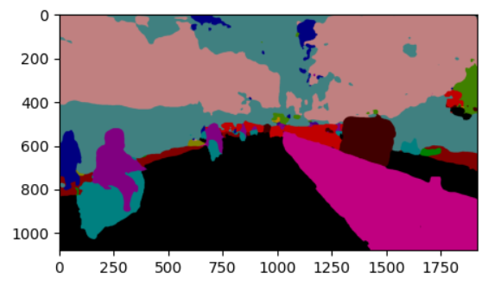
U-NET

Slide 9
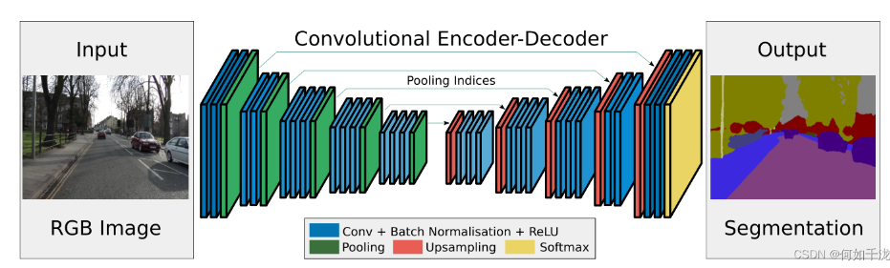
Segnet
Segnet :
SegNet is a convolutional neural network (CNN) designed for image segmentation tasks.
Input: SegNet takes an RGB image as its input. Encoder:
The encoder part of SegNet consists of a stack of convolutional layers which capture the hierarchical features of the image.
Pooling layers reduce the spatial resolution of these features and record the locations of the maximum values within each pooling window (pooling indices).
Decoder:
The decoder part uses the pooling indices from the encoder to perform upsampling, restoring the feature maps to the original image resolution.
Additional convolutional layers then refine these upsampled features to generate the final segmentation map, where each pixel is classified into a category.
Output:
The final layer of the decoder network applies a softmax activation function to classify each pixel independently, resulting in a segmented image where each pixel is labeled with the class of the corresponding object.
Difference：
The main difference between SegNet and U-Net is that SegNet uses max-pooling indices for up-sampling in the decoder, while U-Net employs skip connections to merge features from the encoder and decoder, which helps preserve spatial information during up-sampling. U-Net is typically used for medical image segmentation and is structured to better suit precise localization tasks.

Slide 10
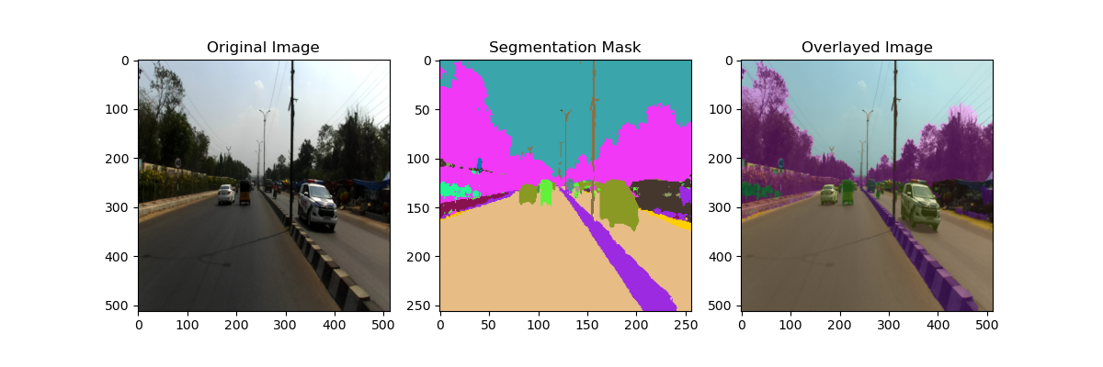
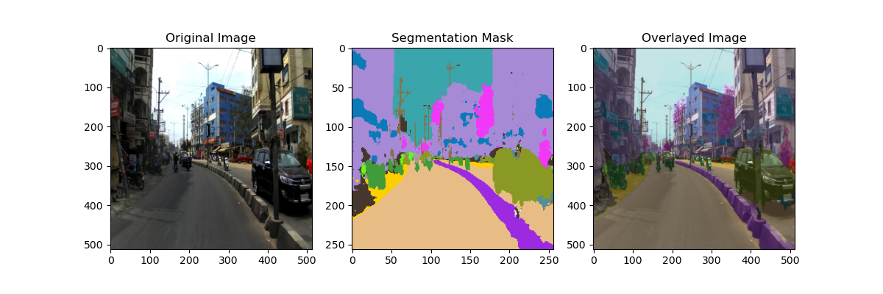
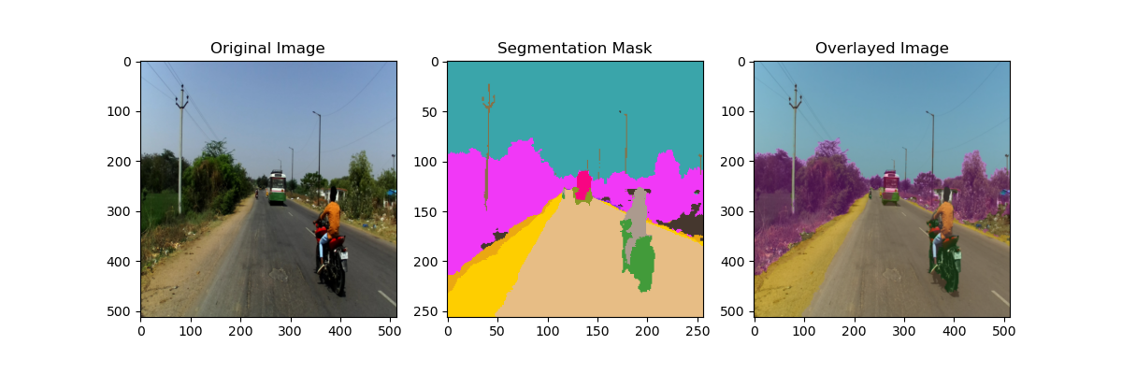
Some visual results

Slide 11
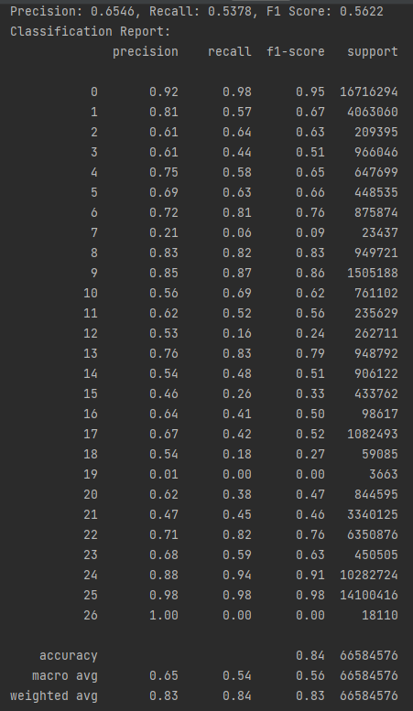
Classification report

Slide 12
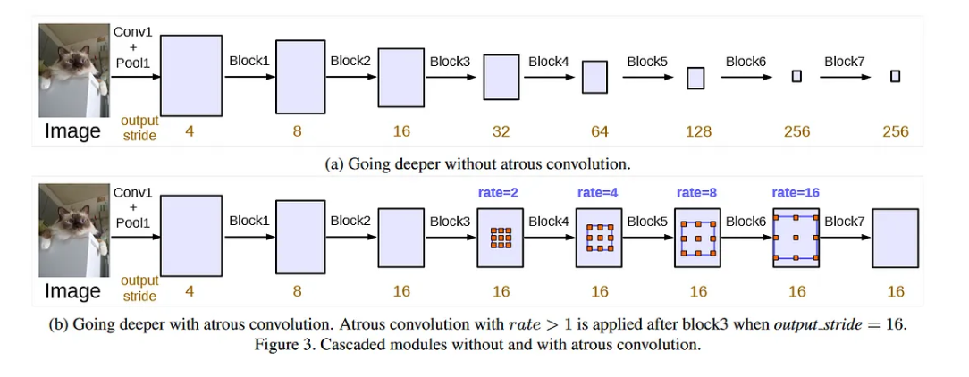
DeepLabV3
Atrous Convolution for Semantic Image Segmentation:
Atrous Convolution: Utilizes atrous (dilated) convolution to increase the field of view of filters to capture wider context without increasing the number of parameters.
Encoder: The encoder employs a modified Xception model as a backbone for feature extraction, utilizing depthwise separable convolution to efficiently process images.
ASPP (Atrous Spatial Pyramid Pooling): Applies parallel atrous convolutions with different rates to gather multi-scale information, crucial for segmenting objects at various scales.
Decoder: Includes a simple yet effective decoder module that refines the segmentation results by employing upsampling and concatenation with low-level features from the encoder.
Output: Produces a segmentation map that classifies each pixel into a category, with improved accuracy especially along object boundaries due to the multi-scale feature capture of ASPP.
Performance: DeepLabV3 achieves state-of-the-art performance on a variety of semantic segmentation benchmarks, particularly in challenging scenarios involving small objects and fine details.

Slide 13
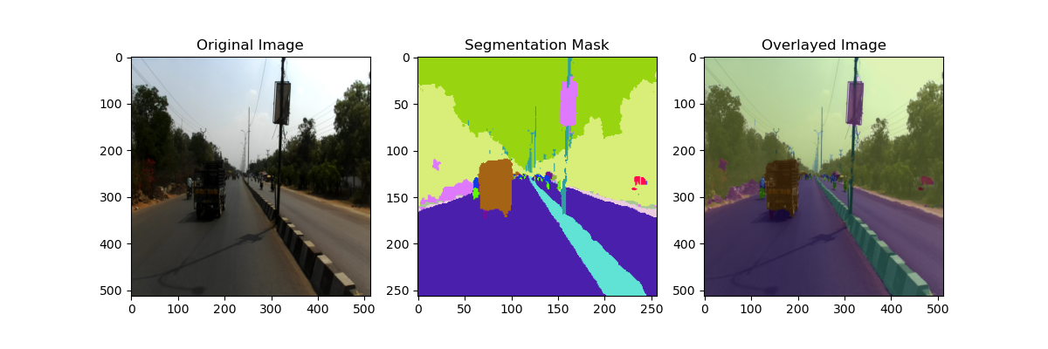
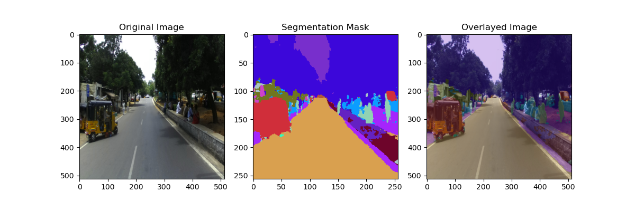
Some results visualization

Slide 14
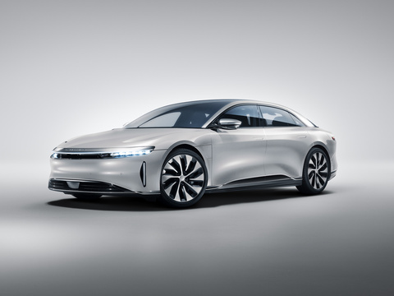
RESULT & DISCUSSION
RESULT & DISCUSSION

Slide 15
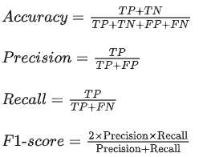
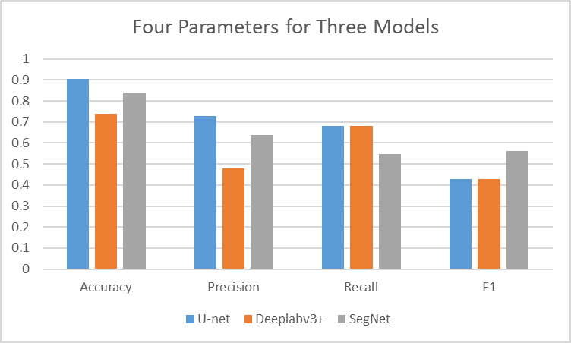
RESULTS
 | Accuracy | Precision | Recall | F1
U-net | 0.904 | 0.73 | 0.68 | 0.428
Deeplabv3+ | 0.74 | 0.48 | 0.68 | 0.43
SegNet | 0.84 | 0.639 | 0.549 | 0.562
Precision shows accuracy in positive predictions.
Recall measures a model's ability to capture all positive instances.
Accuracy evaluates overall correctness, considering both positive and negative instances.
F1 Score strikes a balance between precision and recall, a higher F1 score denotes a better quality classifier.

Slide 16
CONCLUSION
In summary, UNet excels in accuracy. DeepLabv3+ exhibits a more balanced performance, particularly in recall, but lags behind in precision and accuracy. SegNet stands out with competitive F1 Score, making it a strong contender for tasks requiring a balance between precision and recall.
The choice among these models depends on the specific objectives and priorities of the image segmentation task. As for our task, the high accuracy of UNet is remarkable and the high F1 of SegNet is also useful. If the data of the task is more imbalanced, the SegNet performs better.

Slide 17
THE TEAM
Neil Liao z5187710: Introduction & Dataset / Augmentation
Jingjie Xu z5442663: Introducing the U-Net model & explaining the result
ZE CHEN z5449848：Introducing the Segnet model & explaining the result
HANGWEI LIANG z5499015: Introducing the DeeplabV3 model
NUO CHEN z5451234：Result Discussion & Conclusion

Slide 18
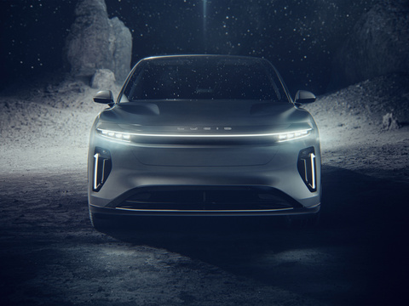
THANK YOU!
COMP9444 TEAM NEXA

